Slide 1
Defensive Security Project
by: Charles S, Nicholas W, Charles B, Charles W, Alex M, Jacob H, Anthony O

Slide 2
Table of Contents
This document contains the following resources:
Monitoring Environment
Attack Analysis
Project Summary & Future Mitigations

Slide 3

Monitoring Environment
‹#›

Slide 4
Scenario
Virtual Space Industries (VSI) under attack from competitor JobeCorp.
Our team is tasked to detect these attacks.
DAY 1:
Checking logs that are known to be standard to set a baseline.
Creating alerts to allow swift action during an attack.
Day 2:
Inspecting data the alerts would have sent in the event of an attack.
Notes:
VSI is a virtual-reality company, specializing in designing programs for businesses.
We have heard rumors that a competitor JobeCorp, may be launching attacks to disrupt VSI’s business.
Our team has been tasked to set up a monitoring system using Splunk.

Slide 5
Website Monitoring App
‹#›
Notes:
The Add-On App we used was “Website Monitoring”

Slide 6
Website Monitoring
This app uses a modular input to detect downtime and performance problems.
Allows for the use of different visualizations on the same page to display certain information in an easier to digest manner.

Slide 7
Website Monitoring
In the status overview and status history screens you are able to see different visualizations of various data making it easier to understand what is going on at a glance rather than having to dig into the data.
Displays changes and when those changes occurred in the UI

Slide 8
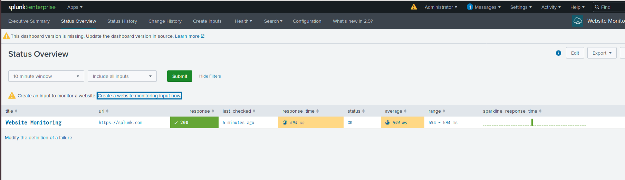
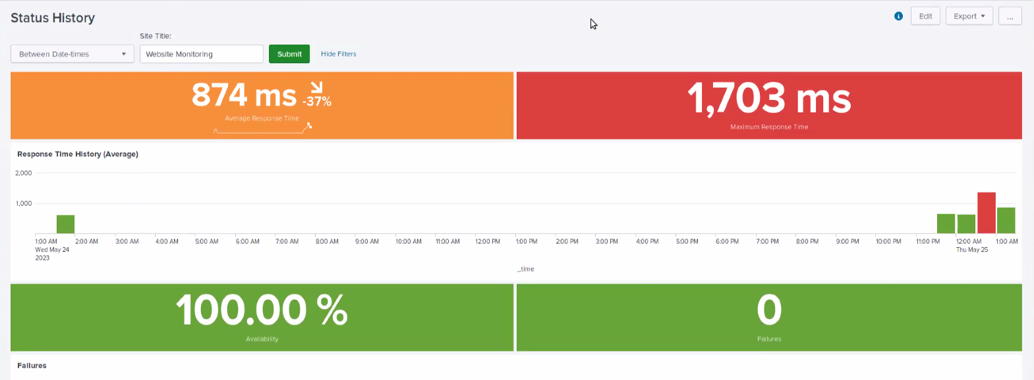
Website Monitoring

Slide 9
Logs Analyzed
Windows Logs
Apache Logs
1
2
Usernames
Signature IDs and Signature Meanings
Status (Success or Failure)
Severity (Level of Importance of data)
User IP Addresses
Status Codes
Method (What each set of data is asking for)
Useragent (How data is being accessed)
Referrer Domain (What website address requests are coming from)

Slide 10
Windows Logs
‹#›

Slide 11
Reports—Windows
Designed the following reports:
Report Name | Report Description
Signatures and Associated ID’s | Allows VSI to view reports that show the ID number associated with the specific signature for Windows activity.
Severity Levels Report | Allows VSI to rapidly identify the severity levels of the Windows logs being viewed.
Success VS Failure Report | Allows VSI to identify if there is a suspicious level of failed activities on the server.

Slide 12
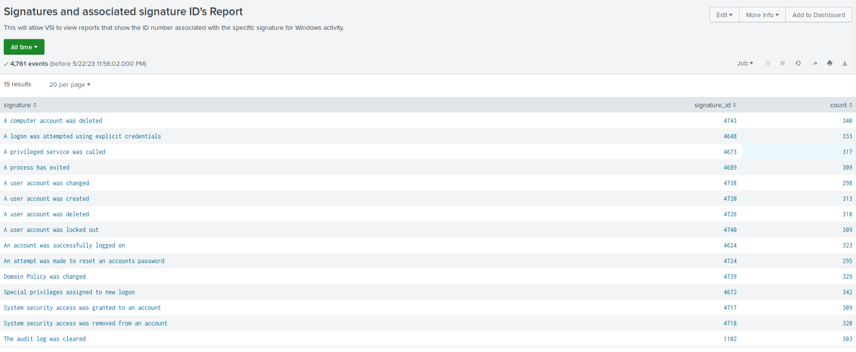
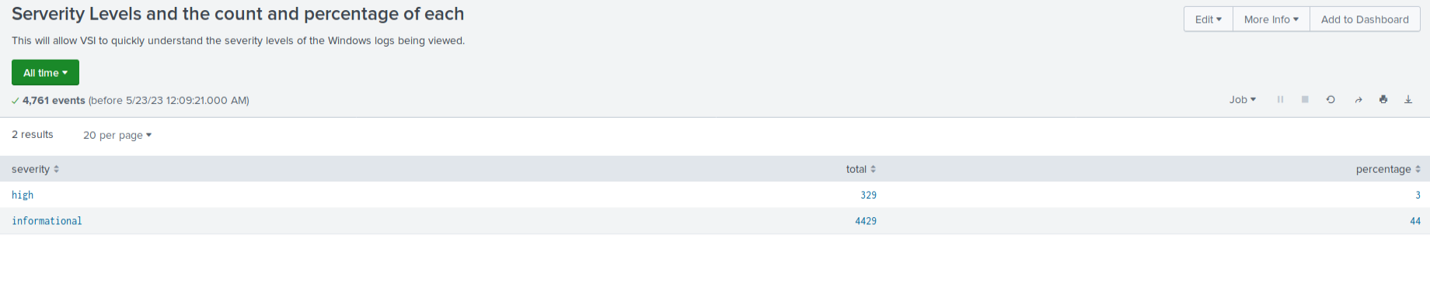
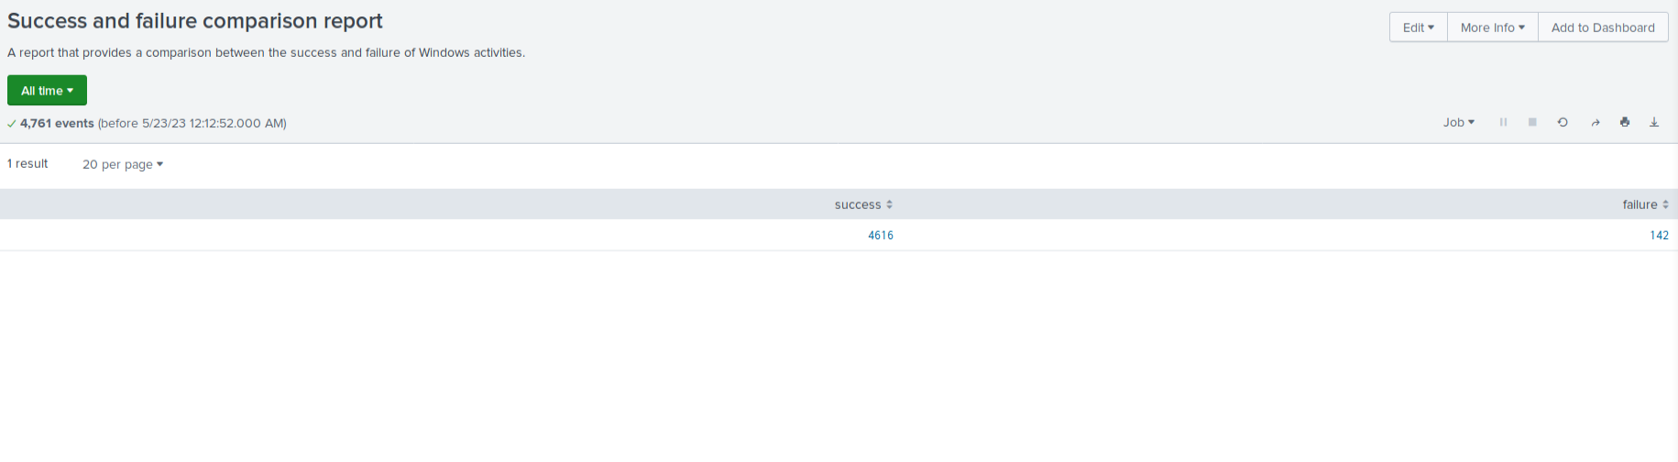
Images of Reports—Windows
Report Image
Report Image
Report Image

Slide 13
Alerts—Windows
Designed the following alerts:
Alert Name | Alert Description | Alert Baseline | Alert Threshold
Failed Windows Alert | Notifies VSI of suspicious level of failed activity on the Windows server | 10 | 15
JUSTIFICATION: When viewing the average number of failed events we concluded that a threshold of 15 would be set to notify administrators of suspicious activity while minimizing false alerts.

Slide 14
Alerts—Windows
Designed the following alerts:
Alert Name | Alert Description | Alert Baseline | Alert Threshold
Account Logon Alert | Alerts VSI administrators when the threshold for normal account logon activity has been exceeded | 20 | 25
JUSTIFICATION: When viewing average logon activity we decided the baseline for normal activity was 20 and set the threshold at 25 to ensure to be alerted but also minimize false alerts.

Slide 15
Alerts—Windows
Designed the following alerts:
Alert Name | Alert Description | Alert Baseline | Alert Threshold
User Account Deleted Alert | Alerts VSI administrators when the threshold for deleted user accounts has been exceeded. | 21 | 26
JUSTIFICATION: When comparing the average number of user accounts deleted, we determined the baseline to be 21 and set the threshold to 26 in order to detect abnormally high counts while preventing false alerts.

Slide 16
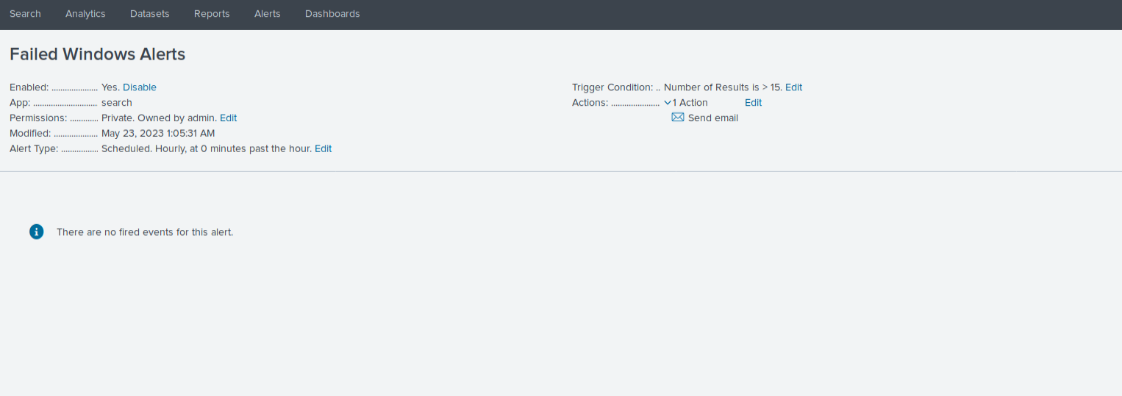
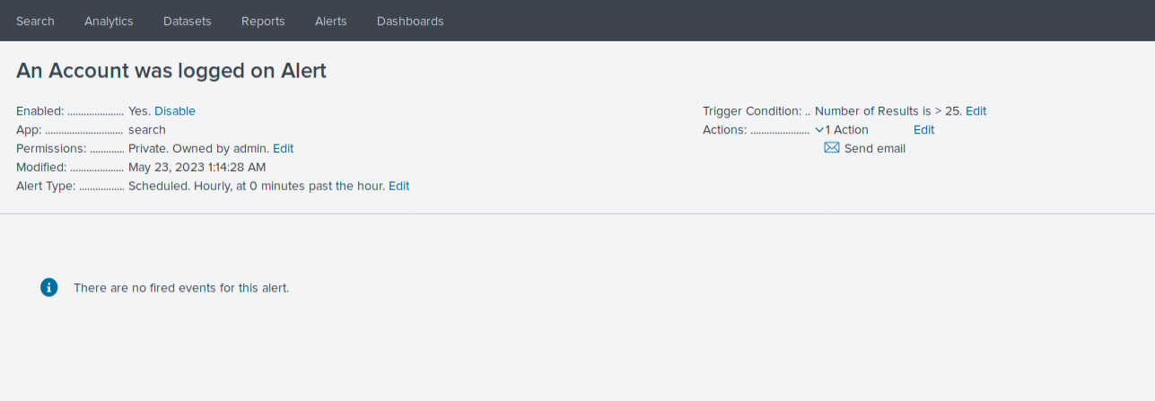
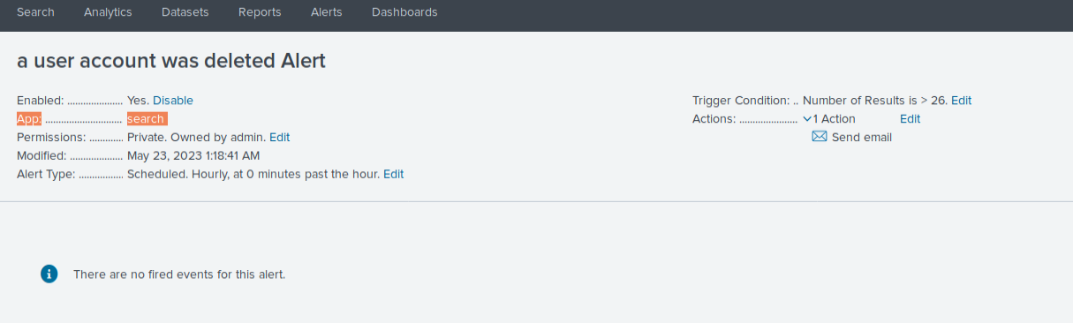
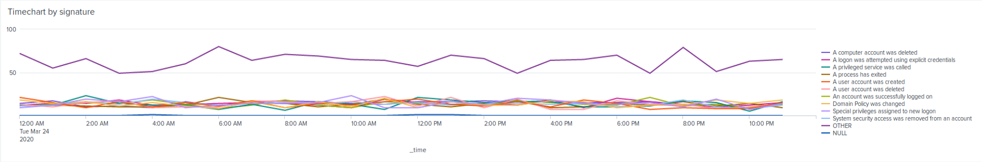
Dashboards—Windows
Place image here
Place image here
Place image here
Place image here

Slide 17
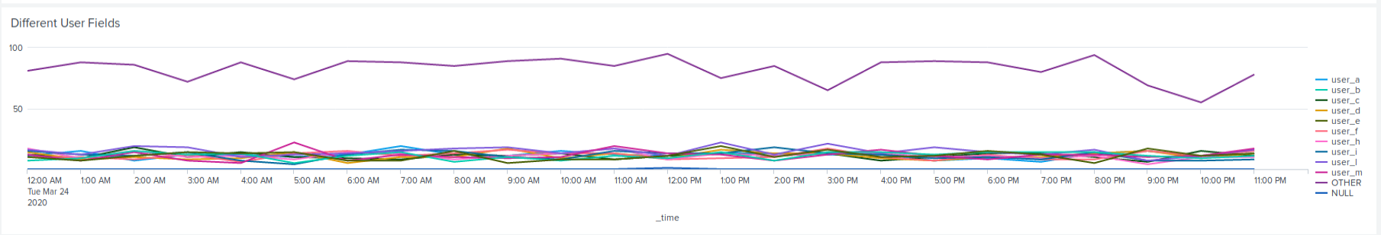
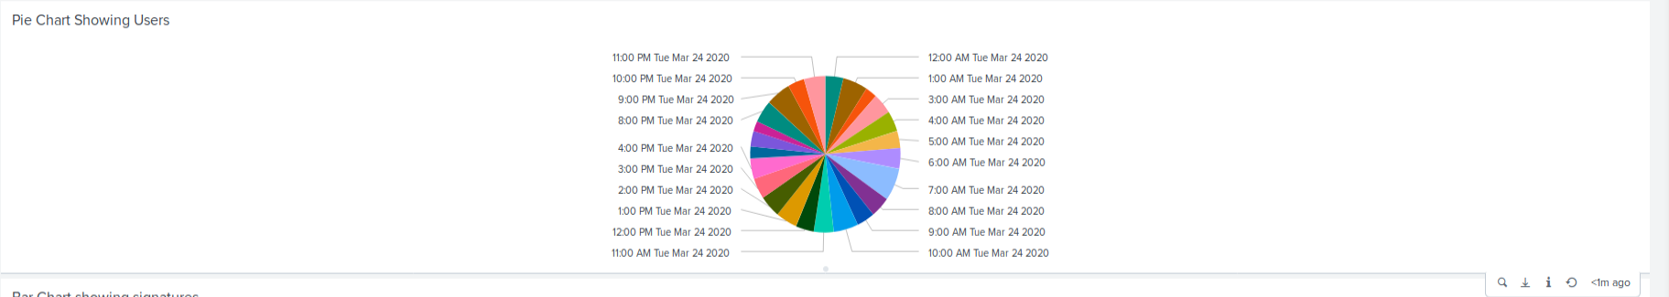
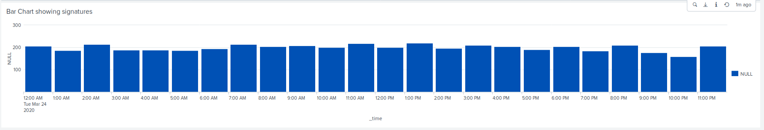
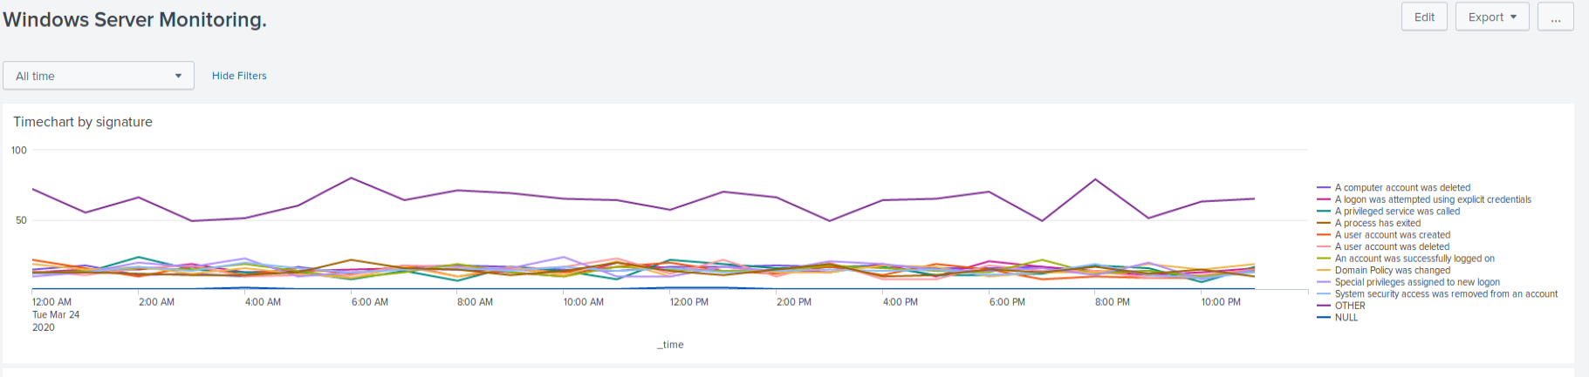
Dashboards—Windows
Place image here
Place image here
Place image here
Place image here

Slide 18
Apache Logs
‹#›

Slide 19
Reports—Apache
Designed the following reports:
Report Name | Report Description
HTTP methods Report | Report designed to illustrate the types of HTTP activity being requested against VSI’s web server.
Domain Referrers Report | Report provides the top 10 domains that refer VSI’s website and will allow VSI to identify any suspicious referrers.
HTTP Response Codes Report | Report designed to provide insight into any suspicious levels of HTTP responses.

Slide 20
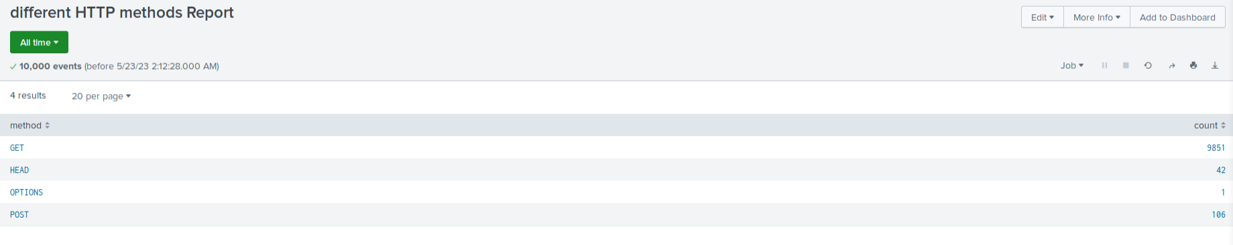
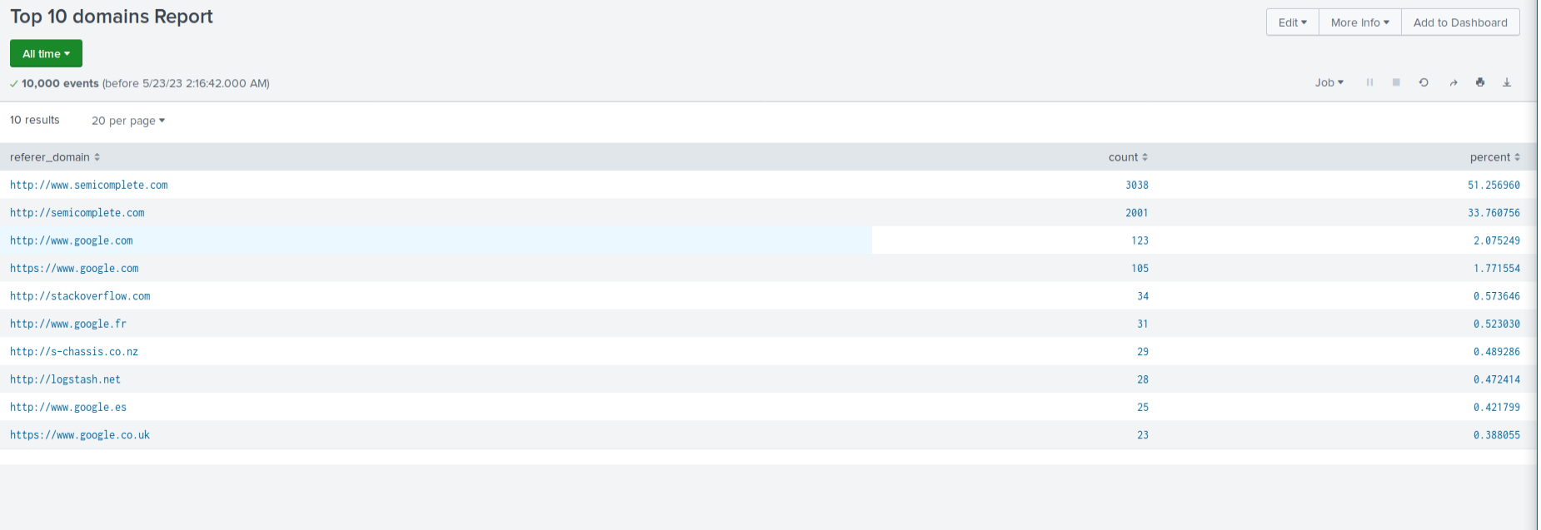
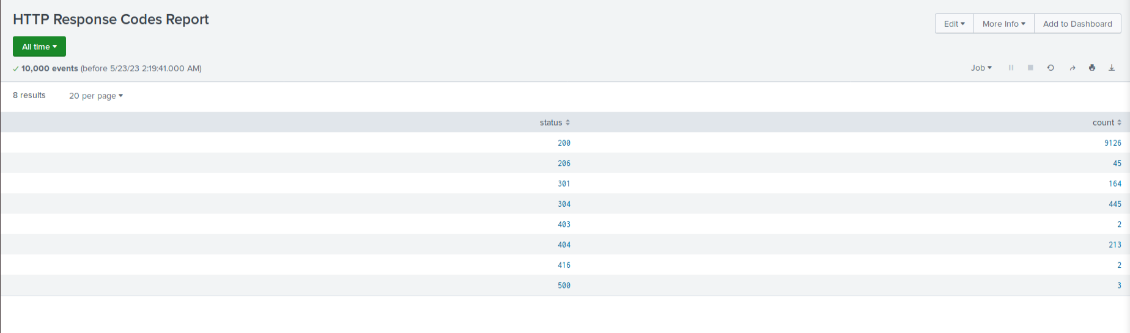
Images of Reports—Apache
Report Image
Report Image
Report Image

Slide 21
Alerts—Apache
Designed the following alerts:
Alert Name | Alert Description | Alert Baseline | Alert Threshold
Activity Outside USA Alert | Alerts administrators when the threshold for hourly activity from any country outside the USA has been exceeded. | 90 | 100
JUSTIFICATION: When comparing the average amount of activity from countries outside the USA, we determined the baseline to be 90 and set the threshold to 100 in order to detect abnormally high counts while preventing false alerts.

Slide 22
Alerts—Apache
Designed the following alerts:
Alert Name | Alert Description | Alert Baseline | Alert Threshold
HTTP Post Alert | Alerts VSI’s administrators when the hourly threshold of HTTP POST responses has been exceeded. | 7 | 12
JUSTIFICATION: When comparing the average number of hourly HTTP POST responses, we determined the baseline to be 7 and set the threshold to 12 in order to detect abnormally high counts while preventing false alerts.

Slide 23
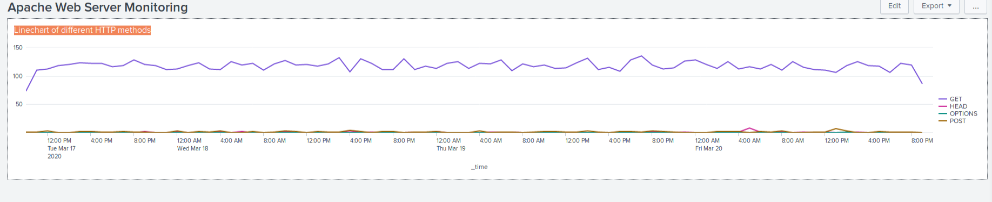
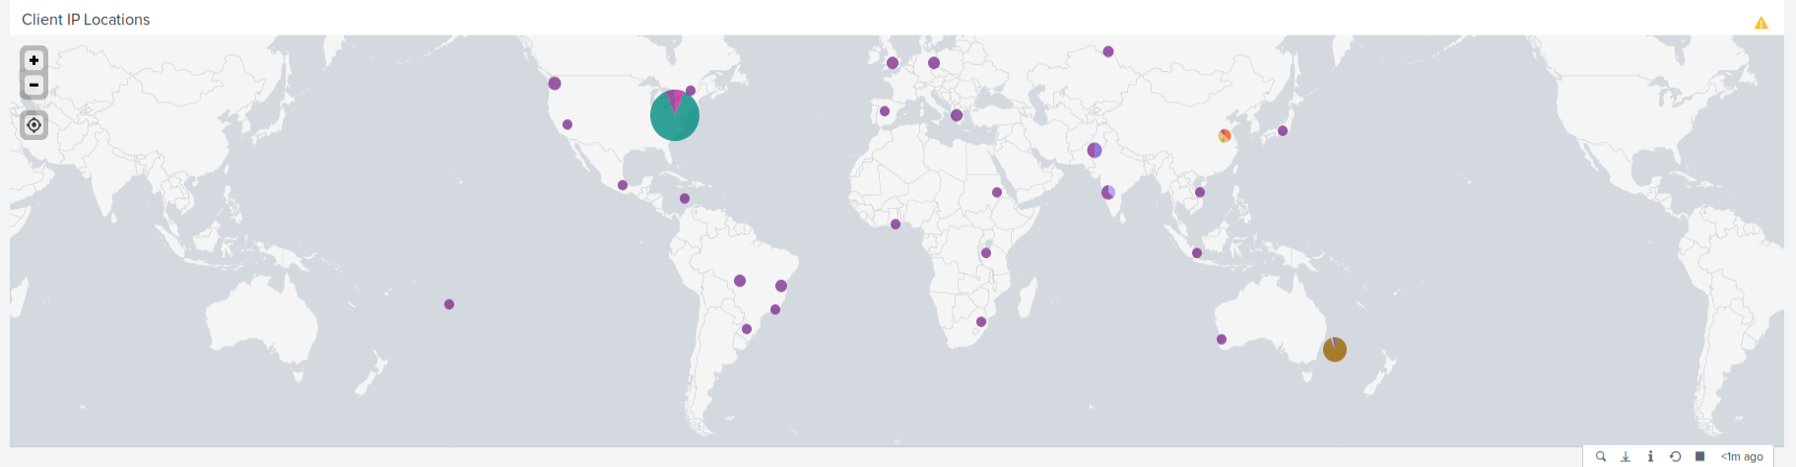
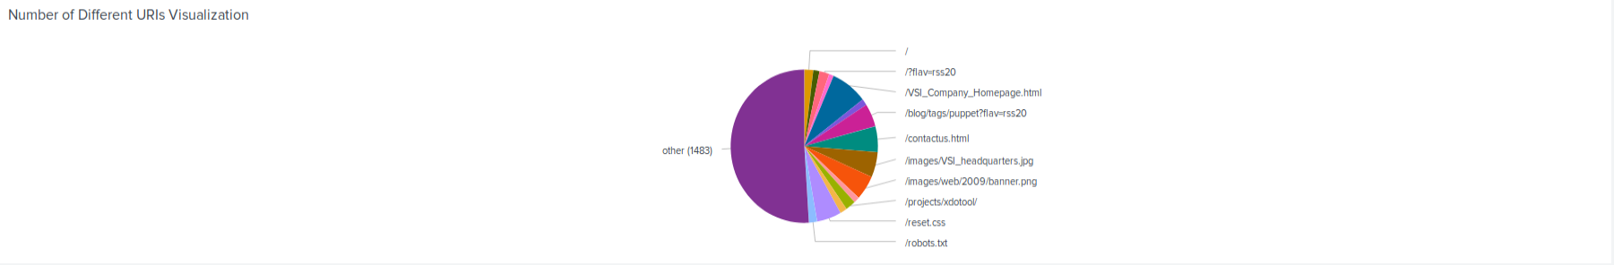
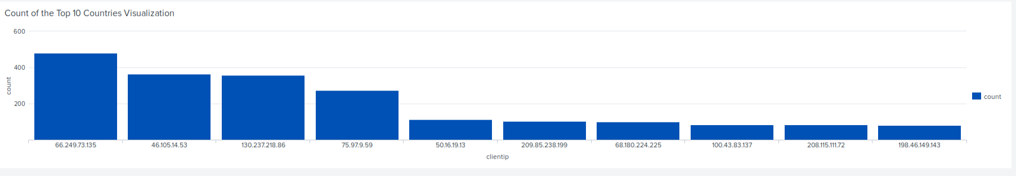
Dashboards—Apache
Place image here
Place image here
Place image here
Place image here

Slide 24
Attack Analysis
‹#›

Slide 25
Attack Summary—Windows
Summarize your findings from your reports when analyzing the attack logs.
When analyzing the attack logs, we were able to find several instances of suspicious activity.
The alerts for failed activities, and suspicious logins were triggered
The visualizations on our dashboards allowed us to assess the information quickly and determine where the suspicious activity was occurring

Slide 26
Attack Summary—Windows
Summarize your findings from your alerts when analyzing the attack logs. Were the thresholds correct?
Our thresholds seemed to be accurate and they successfully alerted our team to the suspicious activity.
35 failed events occurred between 8am and 9am, this triggered our alert
Between 11:00am and 1:00pm both 1 hr chunks triggered out alerts for successful logins with one count being 196, and the other being 77.

Slide 27
Attack Summary—Windows
Summarize your findings from your dashboards when analyzing the attack logs.
Several key points were identified, specifically noting that on 3/25/2020 around 1:00am to 2:00am the signature “A user account was locked out” spiked between 805 to 896. Also on the same day at 9:00am to 10:00am the signature “An attempt was made to reset an accounts password” also spiked between 1,258 to 761. During the 1:00am anomaly user_a also spiked in activity. During the 9:00am anomaly user_k spiked in activity.

Slide 28
Attack Summary—Apache
Summarize your findings from your reports when analyzing the attack logs.
Analysis of Apache logs revealed high volumes of POST and GET requests originating from Kiev and Kharkiv, Ukraine. The referring domains were normal compared to the apache_log files. There was also a surge in HTTP response codes 301, 304, and 404.

Slide 29
Attack Summary—Apache
Summarize your findings from your alerts when analyzing the attack logs. Were the thresholds correct?
Suspicious activity was detected outside the US, notably in Ukraine, at 8:00 PM. The apache_logs alert would have triggered, suggesting an appropriate threshold. On 03/25/2020, POST and GET requests significantly exceeded the threshold at 6:00 PM and 8:00 PM, confirming the current threshold's effectiveness

Slide 30
Attack Summary—Apache
Summarize your findings from your dashboards when analyzing the attack logs.
Spikes in GET and POST responses occurred on 3/25/2020 at 6:00 PM and 8:00 PM coming from Ukraine. The most accessed URI being /VSI_Account_logon.php which was accessed 1,296 times at 8:00 PM. That data led us to conclude a possible SQL Injection attack and bruteforce attacks could have been attempted.

Slide 31
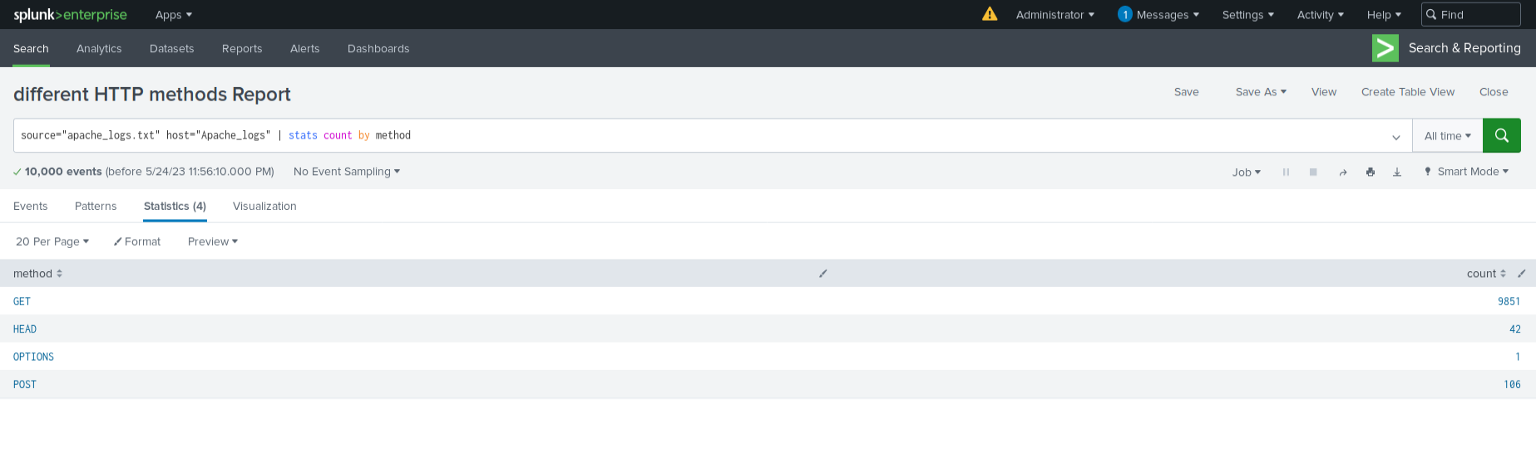
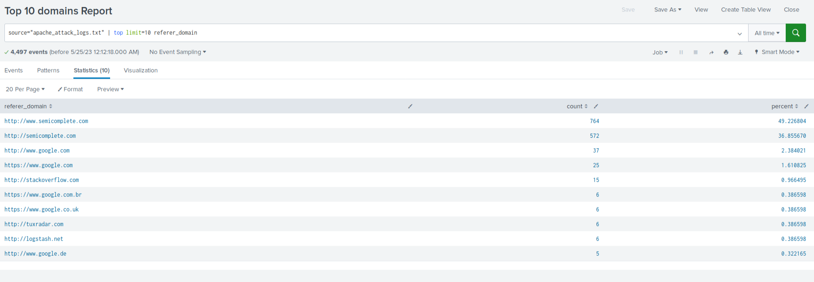
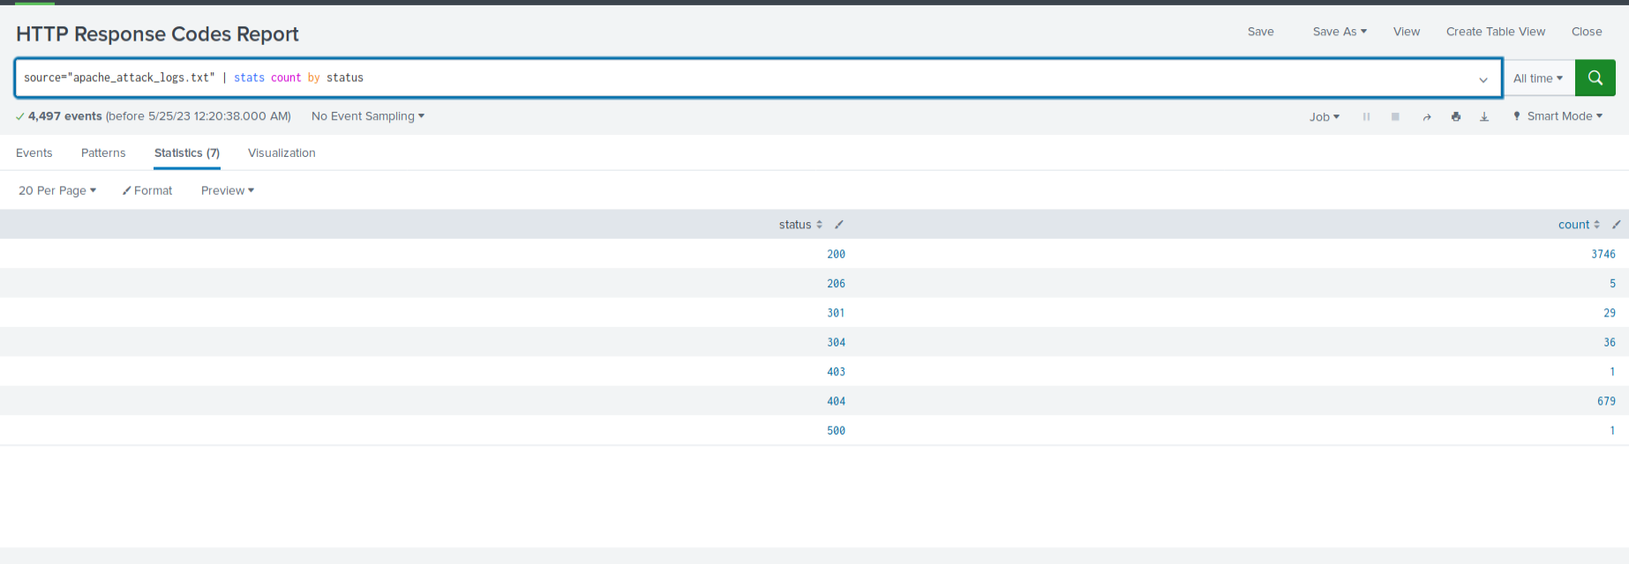
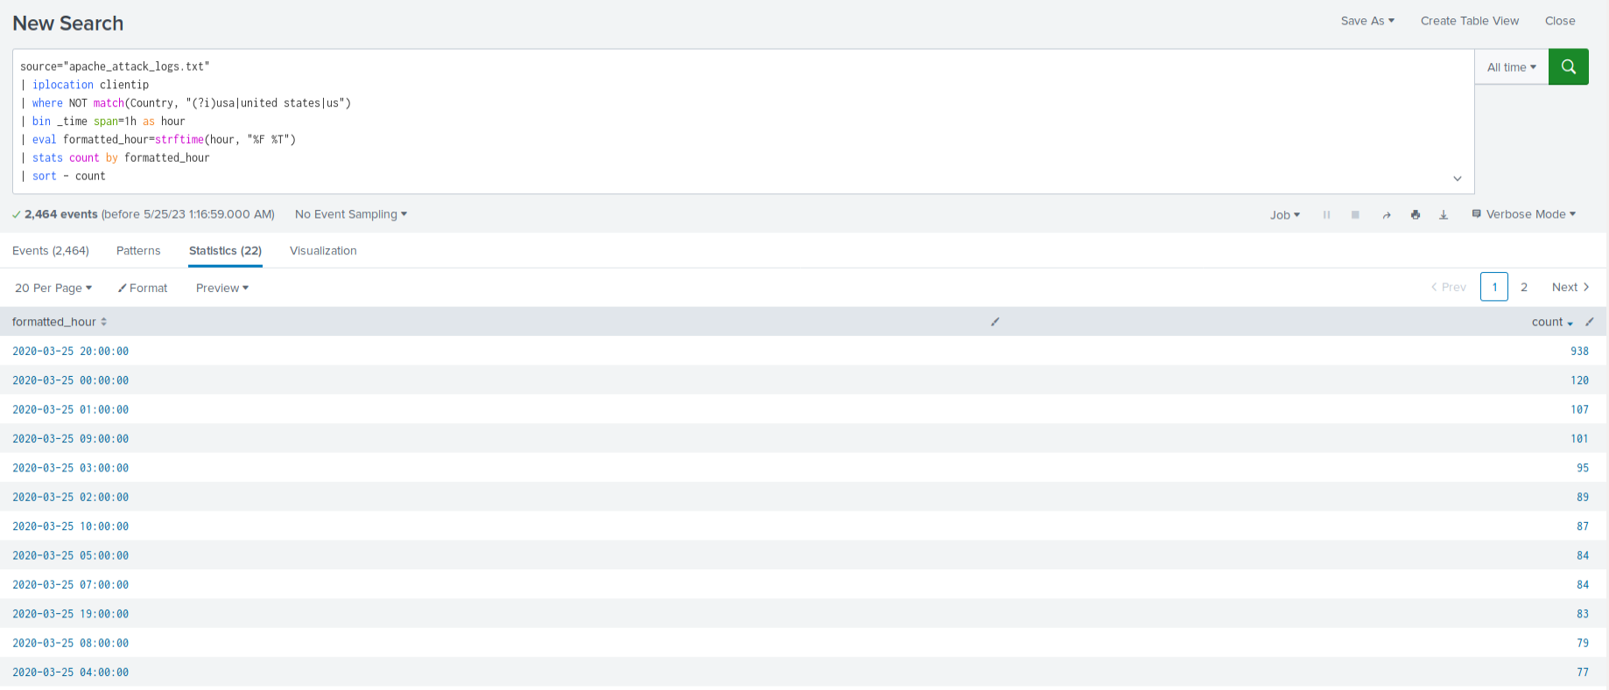
Screenshots of Attack Logs
HTTP report for apache
Top 10 domains Report
Report Analysis for HTTP Response Codes
Alert Analysis for International Activity

Slide 32
Summary and Future Mitigations
‹#›

Slide 33
Project 3 Summary
What were your overall findings from the attack that took place?
The attacks were executed by 3 different users (A, K, & J) between 12-3am, 8-11am, & 10am-1pm respectively. Our alerts were adequate enough to detect the changes.
The largest number of get requests came from the Ukraine specifically Kiev and Kharkiv
To protect VSI from future attacks, what future mitigations would you recommend?
Lower the number of failed login attempts before account lockouts occur.
Limit number of HTTP requests by a single IP address.

